Slide 1
NO SQL Databases HBase Cassandra Hive
Dr. Emmanuel S. Pilli
Malaviya NIT Jaipur

Slide 2
What is NoSQL?
Stands for Not Only SQL
Class of non-relational data storage systems
Usually do not require a fixed table schema nor do they use the concept of joins
All NoSQL offerings relax one or more of the ACID properties (next … CAP theorem)
Notes:
2
NoSQL was a term coined by Eric Evans. He states that ‘… but the whole point of seeking alternatives is that you need to solve a problem that relational databases are a bad fit for. …
This is why people are continually interpreting nosql to be anti-RDBMS, it's the only rational conclusion when the only thing some of these projects share in common is that they are not relational databases.’
Emil Elfrem stated it is not a ‘NO’ SQL but more of a ‘Not Only” SQL.

Slide 3
Why NoSQL?
For data storage, an RDBMS cannot be the be-all / end-all
Just as there are different programming languages, need to have other data storage tools in the toolbox
A NoSQL solution is more acceptable to a client now than even a year ago
Notes:
3
-> Too often as consultants, when we talk about data storage, we immediately reach for a relational database.
-> Relational databases offer a very good general purpose solution to many different data storage needs.
-> In other words, it is the safe choice and will work in many situations.
-> Need to have some knowledge of alternatives, if nothing else to know when a NoSQL solution needs further investigation.

Slide 4
The CAP Theorem
Availability
Consistency
Partition tolerance
Notes:
4
PODC:ACM Symposium on Principles of Distributed Computing(PODC)International Conference

Slide 5
The CAP Theorem
Once a writer has written, all readers will see that write
Availability
Consistency
Partition tolerance

Slide 6
The CAP Theorem
System is available during software and hardware upgrades and node failures.
Availability
Consistency
Partition tolerance

Slide 7

The CAP Theorem
A system can continue to operate in the presence of a network partition failures.
Availability
Consistency
Partition tolerance

Slide 8
The CAP Theorem
Theorem: You can have at most two of these properties for any shared-data system
Availability
Consistency
Partition tolerance
ACID vs BASE

Slide 9
ACID
Atomic
All operations in a transaction succeed or every operation is rolled back.
Consistent
On the completion of a transaction, the database is structurally sound.
Isolated
Transactions do not contend with one another. Contentious access to data is moderated by the database so that transactions appear to run sequentially.
Durable
The results of applying a transaction are permanent, even in the presence of failures.

Slide 10
BASE
Basic Availability
The database appears to work most of the time.
Soft-state
Stores don’t have to be write-consistent, nor do different replicas have to be mutually consistent all the time.
Eventual consistency
Stores exhibit consistency at some later point (e.g., lazily at read time).

Slide 11
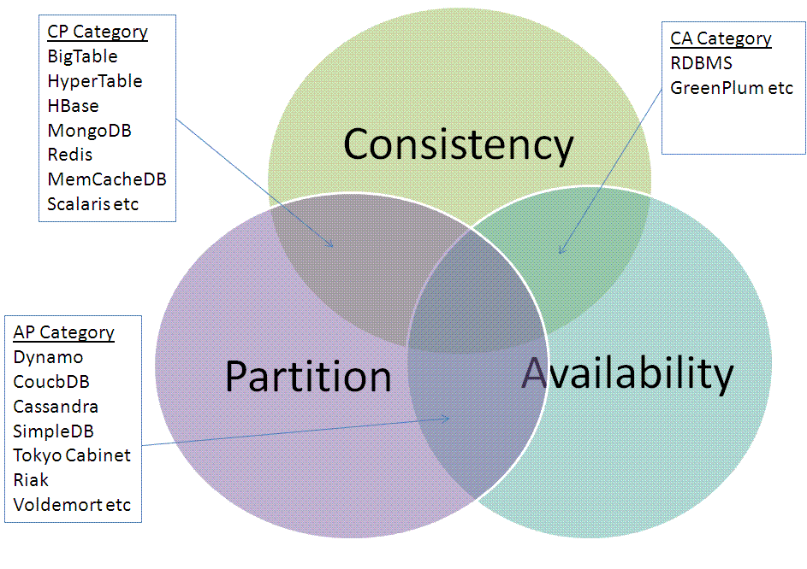
CAP theorem
Notes:
See-
http://link.springer.com/chapter/10.1007%2F978-3-642-35542-4_2
for getting more insights in CAP theorem and NoSQL databases.

Slide 12
NoSQL Options – Key-Value Stores
Extremely simple interface
Data model: (key, value) pairs
Operations: Insert(key,value), Fetch(key),
Update(key), Delete(key)
Some allow (non-uniform) columns within value
Some allow Fetch on range of keys
Examples
Redis, Voldormort
Memcached
and 100s more
Notes:
12

Slide 13
NoSQL Options – Document Stores
Like Key-Value Stores except value is document
Data model: (key, document) pairs
Document: JSON, XML, other semistructured formats
Basic operations: Insert(key,document), Fetch(key),
Update(key), Delete(key)
Also Fetch based on document contents
Example systems
CouchDB, MongoDB, SimpleDB, …

Slide 14
NoSQL Options – Column Stores
Multi-dimensional map
Not all entries are relevant each time
Column families
Examples
Cassandra
Hbase
Amazon SimpleDB
Notes:
14

Slide 15
NoSQL Options – Graph Stores
Data model: nodes and edges
Nodes may have properties (including ID)
Edges may have labels or roles
Relational DBs can model graphs, but an edge requires a join which is expensive
Example Neo4j FlockDB, Titan, Pregel, …
RDF “triple stores” can map to graph databases
Notes:
Short article to understand different nosql data models and how to convert them to graph.
http://www.neo4j.org/learn/nosql
15

Slide 16
NoSQL Database Examples
MongoDB Open-source document database.
CouchDB Database that uses JSON for documents, JavaScript for MapReduce queries, and regular HTTP for an API.
GemFire Distributed data management platform providing dynamic scalability, high performance, and database-like persistence.
Redis Data structure server wherein keys can contain strings, hashes, lists, sets, and sorted sets.
Cassandra Database that provides scalability and high availability without compromising performance.
Notes:
Short article to understand different nosql data models and how to convert them to graph.
http://www.neo4j.org/learn/nosql
16

Slide 17
NoSQL Database Examples
Memcached Open source high-performance, distributed-memory, and object-caching system.
Hazelcast Open source highly scalable data distribution platform.
HBase Hadoop database, a distributed and scalable big data store.
Mnesia Distributed database management system that exhibits soft real-time properties.
Neo4j Open source high-performance, enterprise-grade graph database.
Notes:
Short article to understand different nosql data models and how to convert them to graph.
http://www.neo4j.org/learn/nosql
17

Slide 18
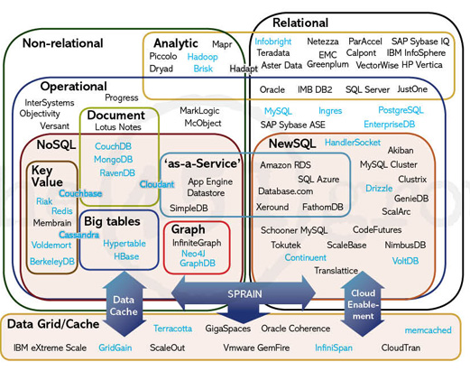
Notes:
18

Slide 19
HBase
Dr. Emmanuel S. Pilli
Malaviya NIT Jaipur

Slide 20
It all started when ..
Google published its paper on BigTable.
The paper put forward a new way of storing and retrieving data
A proven architecture as Google has been using it for many of their successful applications
Primarily geared for web scale data storage and lookups

Slide 21
Why not an RDBMs for such web scale data?
RDBMs tend to scale less better at large data sizes
~500GB (both read and write)
Some RDBMs support sharding but …
Data rearrangement (Resharding) becomes a problem
If the size of shards gets imbalanced
Requires a hashing function to push data into shards
Code for access becomes complex
First find the appropriate shard to locate your data
Pretty much rigid schemas
Why do we need dynamic schemas
Sparse nature of web scale data
Sharding is a type of database partitioning that separates very large databases the into smaller, faster, more easily managed parts called data shards. The word shard means a small part of a whole.

Slide 22
HBase
Column-Oriented data store, known as “Hadoop Database”
Distributed – designed to serve large tables
Billions of rows and millions of columns
Supports random real-time CRUD operations (unlike HDFS) - create, read, update, and delete
Runs on a cluster of commodity hardware
Server hardware, not laptop/desktops
Open-source, written in Java, Part of the Apache Hadoop ecosystem
Type of “NoSQL” DB
Does not provide a SQL based access
Does not adhere to Relational Model for storage
Simple data model
Dynamic control over data layout and format

Slide 23
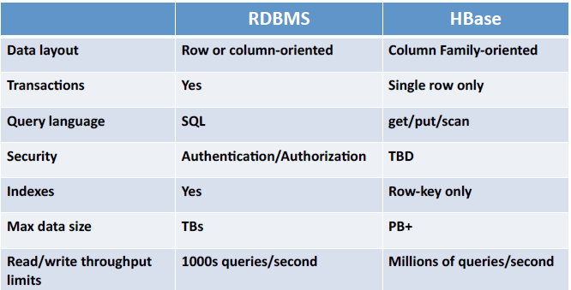
Traditional RDBMS and HBase

Slide 24
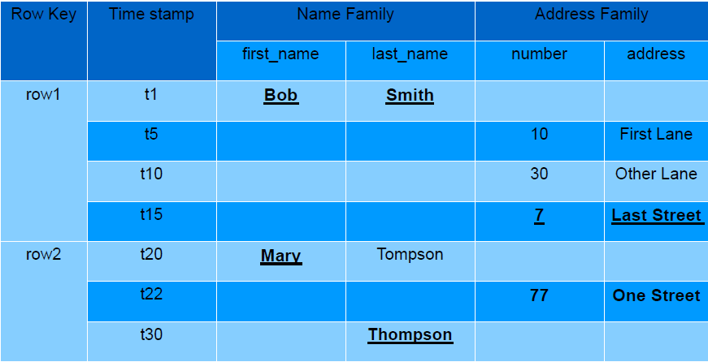
HBase Data Model
Map<byte[], Map<byte[], Map<byte[], Map<Long, byte[]>>>>

Slide 25
HBase Data Model
Data is stored in Tables
Tables contain rows
Rows are referenced by a unique key
Key is an array of bytes – good news
Anything can be a key: string, long and your own serialized data structures
Rows made of columns which are grouped in column families
Data is stored in cells
Identified by row x column-family x column
Cell's content is also an array of bytes

Slide 26
HBase Data Model
Rows are grouped into families
Labeled as “family:column”
Example “user:first_name”
A way to organize your data
Various features are applied to families
Compression
In-memory option
Stored together - in a file called HFile/StoreFile
Family definitions are static
Created with table, should be rarely added and changed
Limited to small number of families

Slide 27
HBase Families
Family name must be composed of printable characters
Not bytes, unlike keys and values
Think of family:column as a tag for a cell value and NOT as a spreadsheet
Columns on the other hand are NOT static
Create new columns at run-time
Can scale to millions for a family

Slide 28
HBase timestamps
Cells' values are versioned
For each cell multiple versions are kept
3 by default
Another dimension to identify your data
Either explicitly timestamped by region server or provided by the client
Versions are stored in decreasing timestamp order
Read the latest first – optimization to read the current value
You can specify how many versions are kept

Slide 29
HBase Row Keys
Rows are sorted lexicographically by key
Compared on a binary level from left to right
For example keys 1,2,3,10,15 will get sorted as
1, 10, 15, 2, 3
Somewhat similar to Relational DB primary index
Always unique
Some but minimal secondary indexes support

Slide 30
HBase Architecture
A HBase table is made up of regions
Each region is made up of start row key and end row key.
Table = SUM of regions
Region = (tablename, startkey, endkey)
Each region may live on a different node
Each region is made up of HDFS blocks and files
Point where HBase falls back on Hadoop
These building blocks of storage are replicated by Hadoop infrastructure (replication settings configurable)

Slide 31
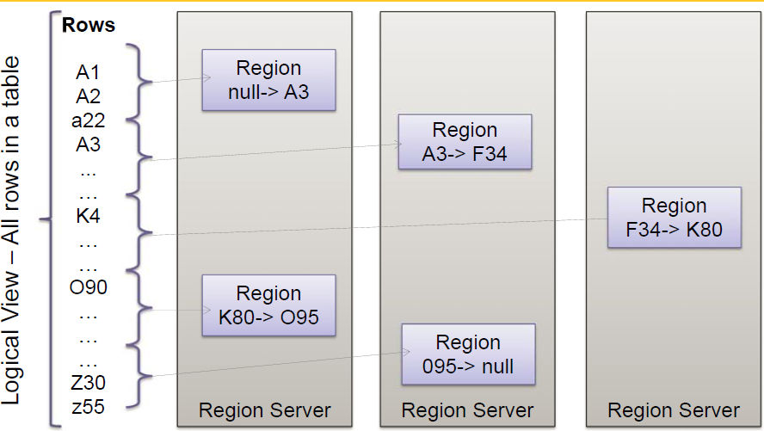
Rows distribution in region servers

Slide 32
HBase Architecture – Contd ..
HBase Nodes are of two types
RegionServer
The actual node where the data is stored
A Region server can hold more than one table.
Master
Manage Region Servers
Load balancing of the Regions
Move the row keys as data is getting inserted so that Regions are almost equally balanced.
This aspect is what gives HBase advantage over RDBMs sharding approaches.
Special tables exist inside HBase
-ROOT-
Stores the schema information
.META.
Stores the Region Servers information

Slide 33
HBase Architecture Implementation
HBase Master
Administration of RegionServers
HRegionServer
Write Requests
Read Requests
Cache Flushes
Compactions
Region Splits
HBase Client
Caching for region lookups

Slide 34
Data Storage
Data is stored in files called HFiles/StoreFiles
Usually saved in HDFS
HFile is basically a key-value map
Keys are sorted lexicographically
When data is added it's written to a log called
Write Ahead Log (WAL) and is also stored in memory (memstore)
Flush: when in-memory data exceeds maximum value it is flushed to an HFile
Data persisted to HFile can then be removed from WAL
Region Server continues serving read-writes during the flush operations, writing values to the WAL and memstore

Slide 35
Data Storage
HDFS doesn't support updates to an existing file therefore HFiles are immutable
Cannot remove key-values out of HFile(s)
Over time more and more HFiles are created
Delete marker is saved to indicate that a record was removed
These markers are used to filter the data - to “hide” the deleted records
At runtime, data is merged between the content of the HFile and WAL

Slide 36
Data Storage
To control the number of HFiles and to keep cluster well balanced HBase periodically performs data compactions
Minor Compaction: Smaller HFiles are merged into larger HFiles (n-way merge)
Fast - Data is already sorted within files
Delete markers are not applied
Major Compaction:
For each region merges all the files within a column-family into a single file
Scan all the entries and apply all the deletes as necessary

Slide 37
HBase – Data Access
HBase Shell
list, get,put, disable, drop,alter,count,describe,scan etc
Java Client API
Table API
Client API for data access, MapReduce
Thrift Server
Thrift compiler, Thrift Server and Thrift client
REST API
Stargate Servlet
Avro Server
Apache Avro is also a cross-language schema compiler
http://avro.apache.org
Requires running Avro Server
HBql
SQL like syntax for HBase
http://www.hbql.com

Slide 38



HBase Map Reduce constructs

Slide 39
When to use HBase
Use HBase if…
You need random write, random read, or both (but not neither)
You need to do many thousands of operations per second on multiple TB of data
Your access patterns are well-known and simple
Don’t use HBase if…
You only append to your dataset, and tend to read the whole thing
You primarily do ad-hoc analytics (ill-defined access patterns)
Your data easily fits on one beefy node

Slide 40
References
An Excellent blog on HBase Architecture
http://www.larsgeorge.com
HBase Wiki
http://wiki.apache.org/hadoop/Hbase
Some presentations made on HBase
http://wiki.apache.org/hadoop/HBase/HBasePresentations

Slide 41
Cassandra
Dr. Emmanuel S. Pilli
Malaviya NIT Jaipur

Slide 42
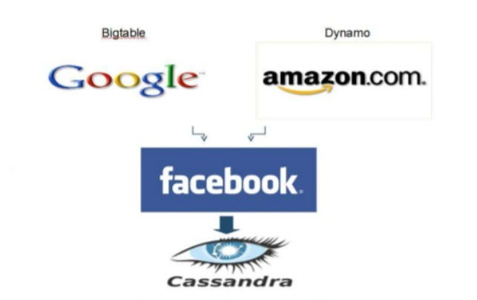
The History of Cassandra

Slide 43
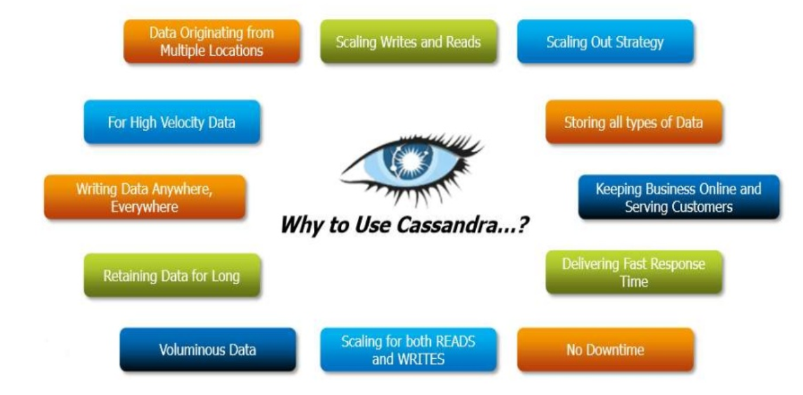
Why Use Cassandra?

Slide 44
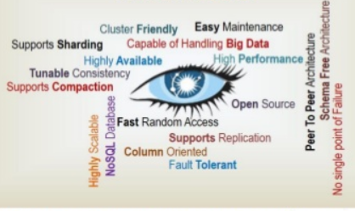
Cassandra Characteristics…

Slide 45
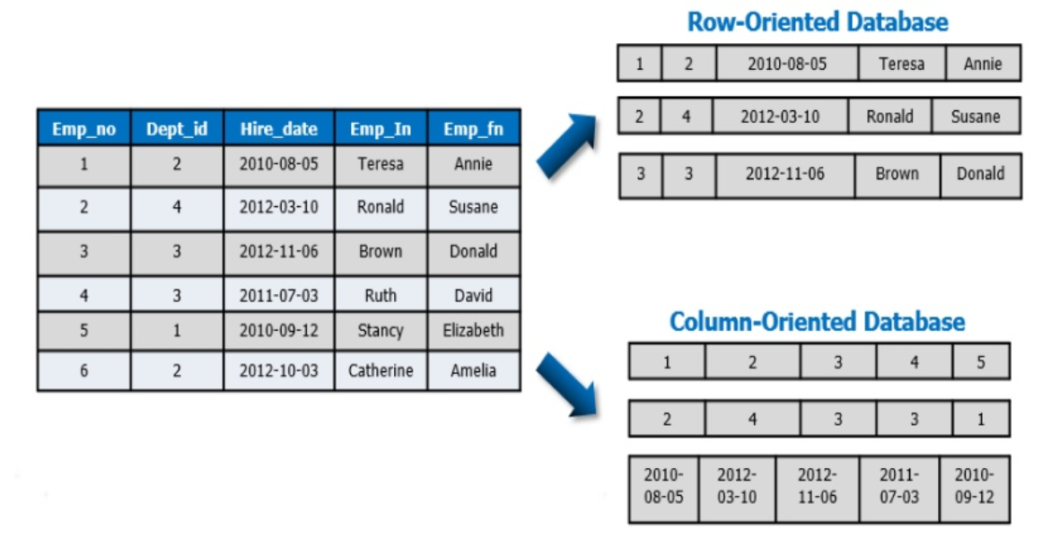
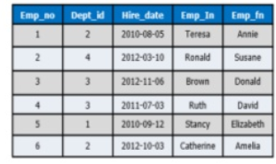
Column Oriented

Slide 46
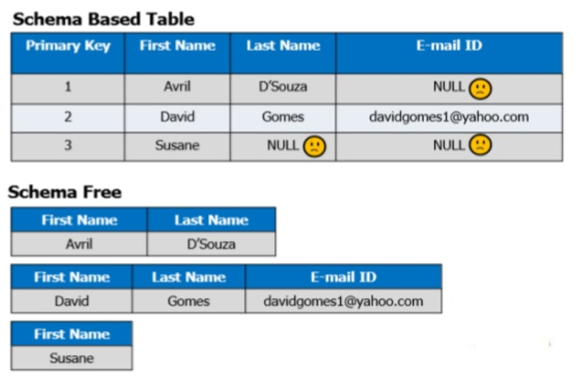
Schema Free

Slide 47
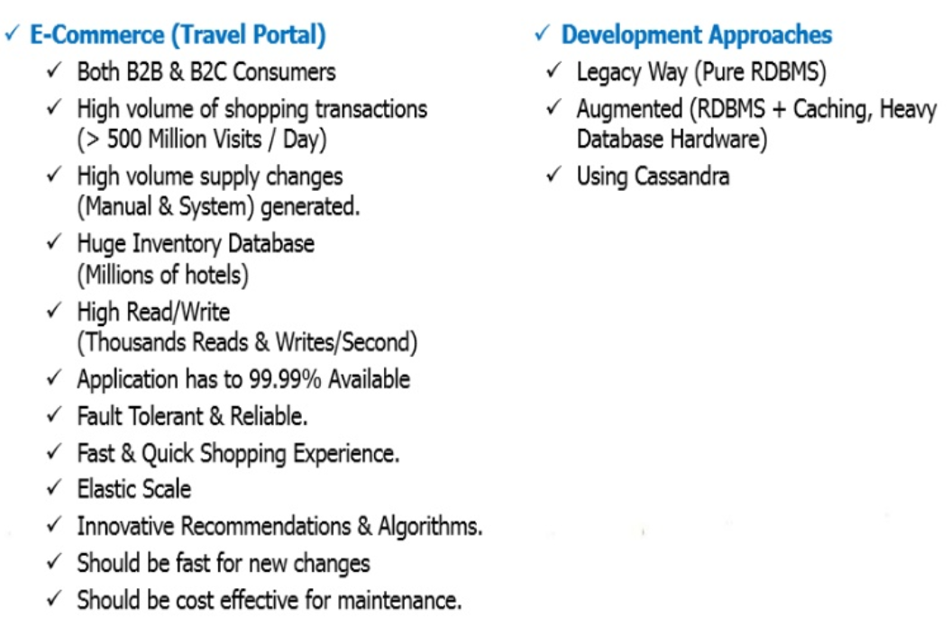
Cassandra Use Case - Summary

Slide 48
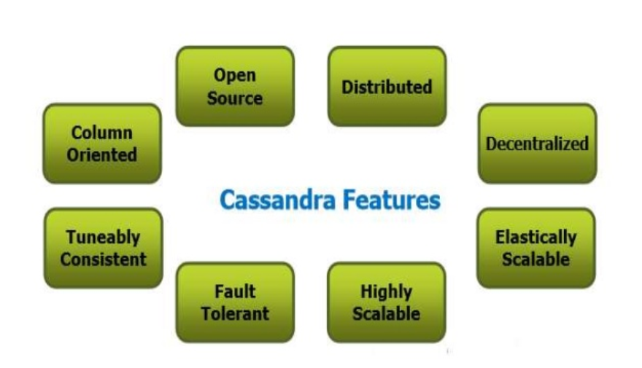
What is Apache Cassandra?
Apache Cassandra is an open source, distributed, decentralized, elastically scalable, highly available, fault-tolerant, Tuneably consistent, column-oriented database.

Slide 49
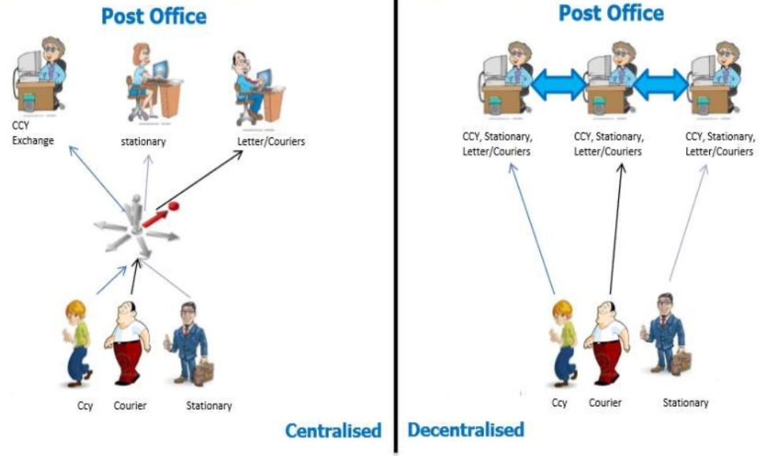
Distributed and Decentralized

Slide 50
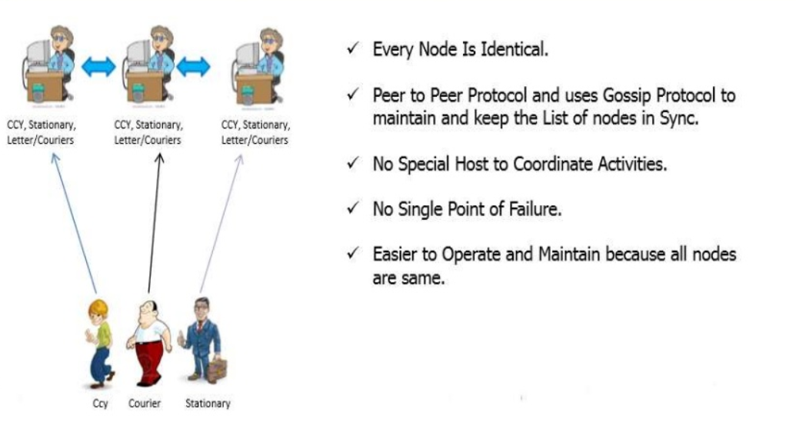
Distributed and Decentralized

Slide 51
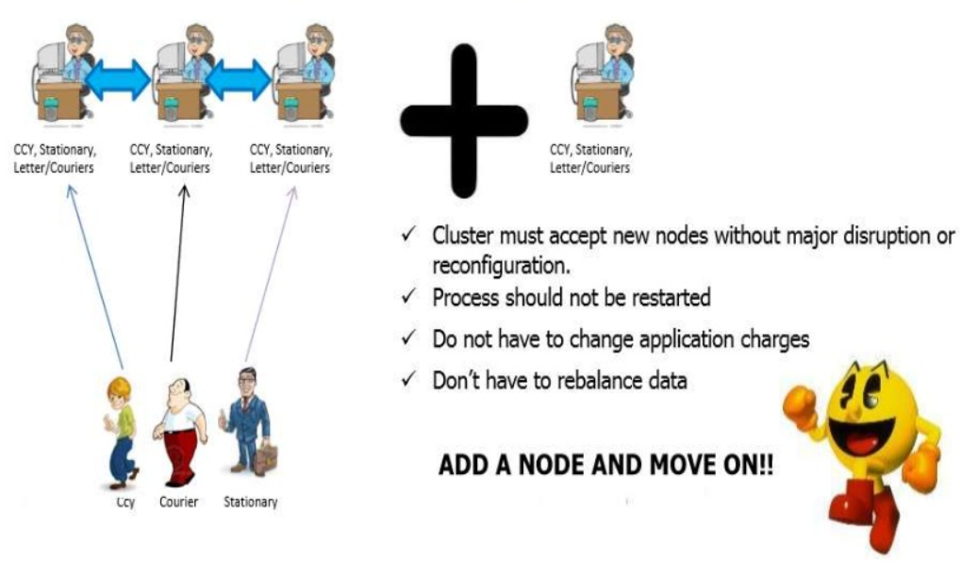
Elastic Scalability

Slide 52
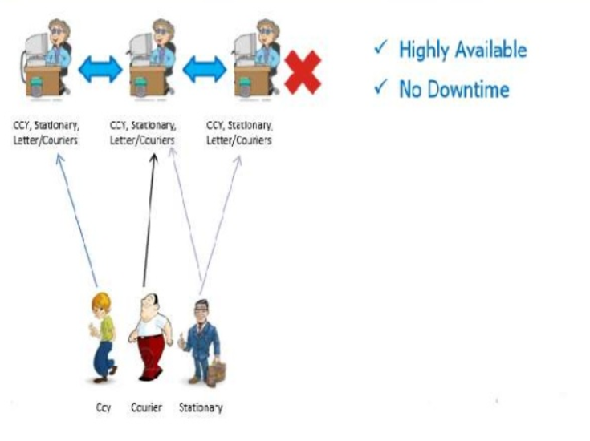
High Avalability and Fault Tolerance

Slide 53
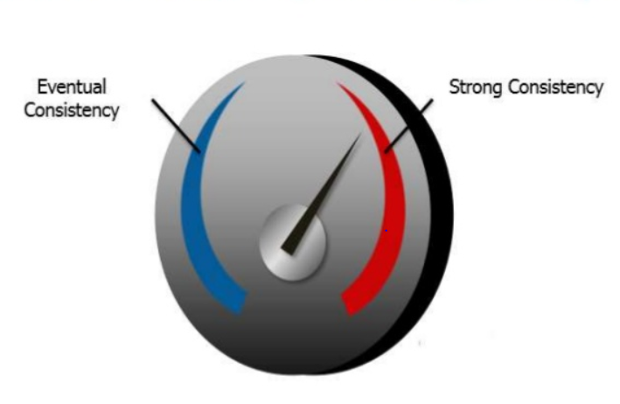
Tunable Consistency
Cassandra enables us to tune the Consistency based on Application Requirement.

Slide 54
High Performance
Cassandra was designed specifically from the ground up to take full advantage of multiprocessor / multicore machines and to run across many dozens of these machines housed in multiple data centres.
It scales consistently and semlessly to hundreds of terabytes.
Shows exceptional performance under heavy loads.
Consistently shows very fast throughput for writes per seconds on a basic commodity workstation.

Slide 55
Where to Use Cassandra?
Use if your application has:
Big Data (Billions of Records Rows & Columns)
Very High Velocity Random Reads & Writes
No Multiple Secondary Index Needs
Low Latency
Use Cases:
eCommerce Inventory Cache Use Cases
Time Series / Events Use Cases
Feed Based Activity / Use Cases

Slide 56
Where NOT to Use Cassandra?
Don’t Use if your application has:
Secondary Indexes.
Relational Data.
Transactional (Rollback, Commit)
Primary & Financial Records.
Stringent Security & Authorization Needs On Data.
Dynamic Queries on Columns.
Searching Column Data.
Low Latency.

Slide 57
HIVE
Dr. Emmanuel S. Pilli
Asst. Professor, CSE, MNIT Jaipur

Slide 58
Why Another Data Warehousing System?
Problem : Data, data and more data
Several TBs of data everyday
The Hadoop Experiment:
Uses Hadoop File System (HDFS)
Scalable/Available
Problem
Lacked Expressiveness
Map-Reduce hard to program
Solution : HIVE

Slide 59
What is Hive?
A system for managing and querying unstructured data as if it were structured
Uses Map-Reduce for execution
HDFS for Storage
Key Building Principles
SQL as a familiar data warehousing tool
Extensibility (Pluggable map/reduce scripts in the language of your choice, Rich and User Defined Data Types, User Defined Functions)
Interoperability (Extensible Framework to support different file and data formats)
Performance

Slide 60
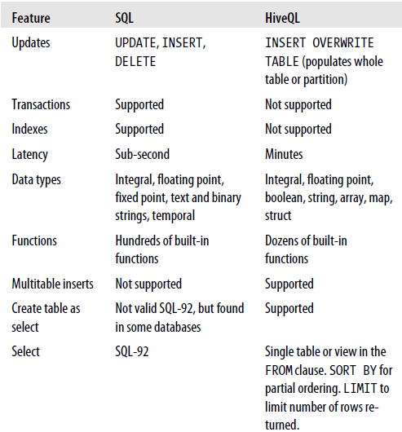
SQL vs HiveQL

Slide 61
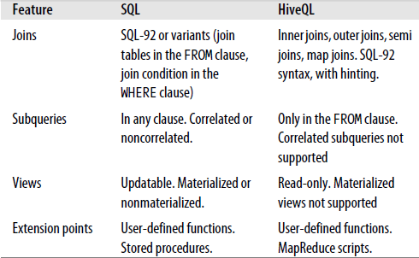
SQL vs HiveQL

Slide 62
HiveQL: Type System
Primitive types
Integers:TINYINT, SMALLINT, INT, BIGINT.
Boolean: BOOLEAN.
Floating point numbers: FLOAT, DOUBLE .
String: STRING.
Complex types
Structs: {a INT; b INT}.
Maps: M['group'].
Arrays: ['a', 'b', 'c'], A[1] returns 'b‘
Functions
SHOW functions
DESCRIBE FUNCTION funname

Slide 63
Hive Data Model: Tables
Managed Tables:
CREATE TABLE managed_table (dummy STRING);
Hive manages the data
Moves files to warehouse directory [During LOAD operation]
External Tables
CREATE EXTERNAL TABLE external_table (dummy STRING);

Slide 64
Hive Data Model: Partitions
Give extra structure to the data
Useful for more efficient queries.
CREATE TABLE logs (ts BIGINT, line STRING)
PARTITIONED BY (dt STRING, country STRING);
LOAD DATA LOCAL INPATH 'input/hive/partitions/file1'
INTO TABLE logs
PARTITION (dt='2001-01-01', country='GB');
/user/hive/warehouse/logs/dt=2010-01-01/country=GB/file1
/file2
/country=US/file3
/dt=2010-01-02/country=GB/file4
/country=US/file5
/file6

Slide 65
Hive Data Model: Buckets
To enable more efficient queries
JOIN queries
To make sampling more efficient
CREATE TABLE bucketed users (id INT, name STRING)
CLUSTERED BY (id) INTO 4 BUCKETS;

Slide 66
Examples – DDL Operations
CREATE TABLE sample (foo INT, bar STRING) PARTITIONED BY (ds STRING);
SHOW TABLES '.*s';
DESCRIBE sample;
ALTER TABLE sample ADD COLUMNS (new_col INT);
DROP TABLE sample;
Notes:
*Creates a table called invites with two columns and a partition column called ds. The partition column is a virtual column. It is not part of the data itself but is derived from the partition that a particular dataset is loaded into. By default, tables are assumed to be of text input format and the delimiters are assumed to be ^A(ctrl-a).
*lists all the table that end with 's'. The pattern matching follows Java regular expressions.

Slide 67
Examples – DML Operations
LOAD DATA LOCAL INPATH './sample.txt'
OVERWRITE INTO TABLE sample PARTITION (ds='2012-02-24');
LOAD DATA INPATH '/user/falvariz/hive/sample.txt' OVERWRITE INTO TABLE sample PARTITION (ds='2012-02-24');
Notes:
*Loads a file that contains two columns separated by ctrl-a into sample table. 'local' signifies that the input file is on the local file system. If 'local' is omitted then it looks for the file in HDFS.
*The keyword 'overwrite' signifies that existing data in the table is deleted. If the 'overwrite' keyword is omitted, data files are appended to existing data sets.
*The second command will load data from an HDFS file/directory to the table. Note that loading data from HDFS will result in moving the file/directory. As a result, the operation is almost instantaneous.

Slide 68
Importing data
INSERT OVERWRITE TABLE
INSERT OVERWRITE TABLE target
SELECT col1, col2
FROM source;
Multitable Insert
FROM records2
INSERT OVERWRITE TABLE stations_by_year
SELECT year, COUNT(DISTINCT station)
GROUP BY year
INSERT OVERWRITE TABLE records_by_year
SELECT year, COUNT(1)
GROUP BY year
Create Table as Select
CREATE TABLE target
AS
SELECT col1, col2
FROM source;

Slide 69
Querying data
SELECT
SELECT foo FROM sample WHERE ds='2012-02-24‘;
Sorting and Aggregating
FROM records2
SELECT year, temperature
DISTRIBUTE BY year
SORT BY year ASC, temperature DESC;
JOINS:
Inner Joins
SELECT sales.*, things.*
FROM sales JOIN things ON (sales.id = things.id);
Outer Join

Slide 70
Joins…
Semi joins
SELECT *
FROM things
WHERE things.id IN (SELECT id from sales);
We can rewrite it as follows:
Can be written as…
SELECT *
FROM things LEFT SEMI JOIN sales ON (sales.id = things.id);
Map joins
If one table is small enough to fit in memory
SELECT /*+ MAPJOIN(things) */ sales.*, things.*
FROM sales JOIN things ON (sales.id = things.id);

Slide 71
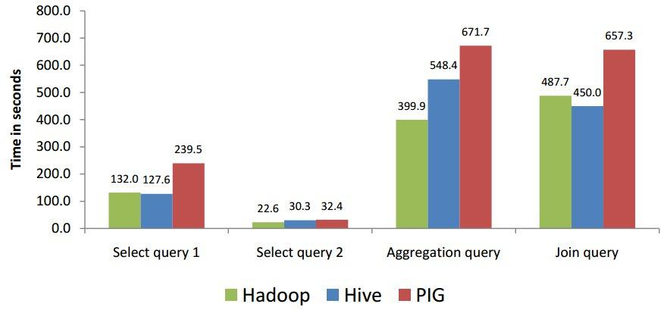
Performance -Result

Slide 72
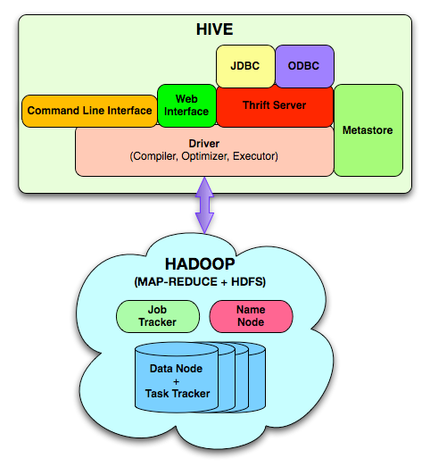
System Architecture and Components

Slide 73
References:
Hadoop: The Definitive Guide
Tom White (Author)
O'Reilly Media; 3rd Edition (May6, 2012)
Programming Hive
Edward Capriolo, Dean Wampler,
Jason Rutherglen (Authors)
O'Reilly Media; 1 edition (October, 2012)
Notes:
Check Case study chapter in “Hadoop and Hive at Facebook” in Hadoop: The definitive Guide book

Slide 74


Any Questions
and Thanks

